Slide 1
Genome Informatics at Iowa State University
Transforming raw data into informative data for researchers
Andrew Severin
Genome Informatics Facility
Iowa State University
206 Science I
Iowa State University

Slide 2
What do I do?
Enable researchers to interpret high-throughput data
Encourage/Contribute to bioinformatics friendly infrastructure
Explore the latest open source software
Develop pipelines for efficient analysis
Contribute to papers and grants (LOS)
Train and Teach Bioinformatics
Write Grants
Meet the needs and communicate well with a diverse faculty to help facilitate NGS research on campus.
http://gif.biotech.iastate.edu
GIF@iastate.edu

Slide 3

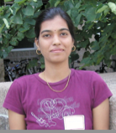

GIF Team
Arun Seetharam
Usha Muppirala
Margie Carter
Notes:
On the point ..
Main issue is I need more staff
Assistant Scientist IV is a new category that could help with hiring options but reduces retention incentives.

Slide 4
Workshop: Basic UNIX for Biologists

Slide 5
Have you ever….
tried to open a very large file (like FASTQ) in PC/Mac?
searching for a specific piece of information from large number of files?
wanted to rename large number of files?
combine large number of files into one big file?
got frustrated with excel auto-correcting your favorite gene?
wanted to run a program that isn’t available on your operating system?
bored of doing same things over and over?
You Need UNIX

Slide 6
What is UNIX?
Widely used multiuser operating system
Linux: free version of UNIX-like operating system
Red Hat Enterprise Linux, Ubuntu, and CentOS
Used on high-end workstations, database servers, web servers and managing shared resources
Standard features include:
Security, reliability, scalability
supports multi-user (as in 100s)

Slide 7
Can I learn UNIX?
Yes! Absolutely. Anyone can if they want.
No more difficult than learning Word, Excel or Powerpoint
Biggest difference
In Unix: You type the command to execute
In Word: You use your mouse to execute a command
Remember. In the Terminal, “don’t touch the mouse”

Slide 8

Kernel and Shells
SHELL
USER 1
KERNEL
USER N
HARDWARE
SHELL types:
Bourne Shell (sh)
C shell (csh)
TC shell (tcsh)
Korn shell (ksh)
Bourne Again Shell (bash)
Z shell (zsh)

Slide 9
Organization
Root Directory, whole tree starts from here
Contains fundamental executables (i.e., binaries) generally used by all users on the system
All users home directories are located here
/
..
etc
dev
home
Parent
Directory
usr
bin
.
My Home!
arnstrm
user2
user3
lib
Present
Directory
folder1
folder2
Relative path for fileA:
./folder2/fileA
Absolute path for fileA:
/home/arnstrm/folder2/fileA
fileA

Slide 10
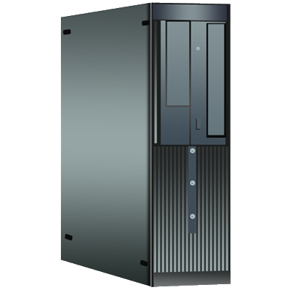
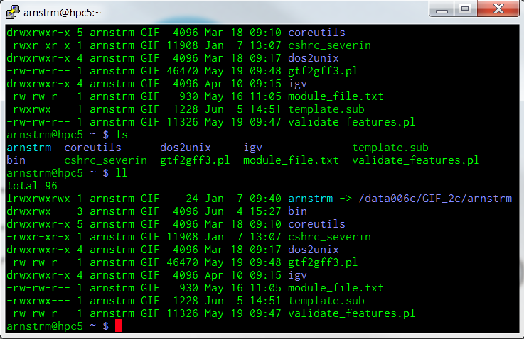
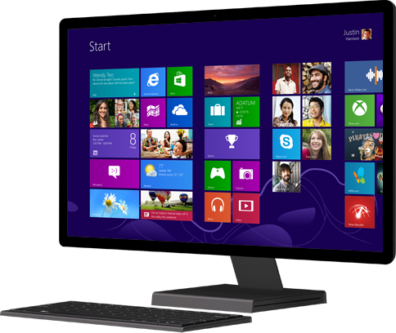
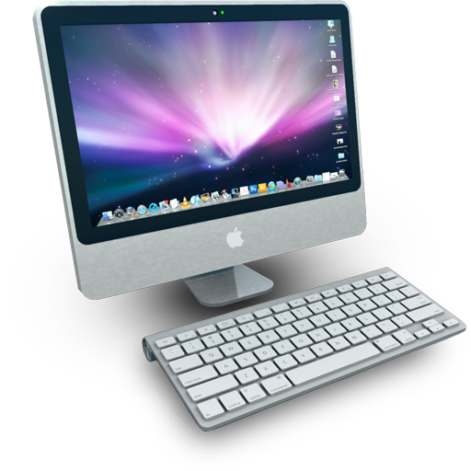
High Performance Computing (HPC)
HPC-class (education)
48 compute nodes
16 processors/node (768 total)
64Gb RAM/node (3.0Tb total)
Lightning3 (research)
17 compute nodes
32 processors/node (384 total)
256Gb RAM/node (3.2Tb total)
Compute Nodes
Condo (up coming)
316 compute nodes
8 processors/node (2528 total)
8Gb RAM/node (3.5Tb total)
Head Node
Terminal
SSH

Slide 11
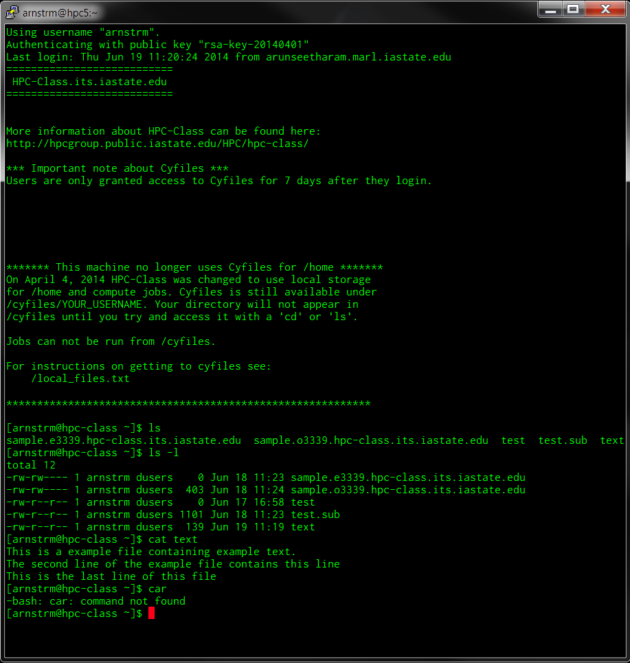
Terminal
welcome message
prompt
command
argument
standard out
standard error

Slide 12
Some things to remember
Commands/Filenames are case sensitive:
Cat ≠ cat
No recycle bin: file deleted is lost forever and cannot be recovered
What you ask is what you get, you need to know the command you type is correct
grep -c '>' FILE ≠ grep -c > FILE # you’ll lose ‘FILE’ forever!
Every single task can be performed in multiple different ways
Special terms cannot be used for names (files, dirs. etc)

Slide 13
Some useful tips
TAB auto completion: makes it easy to complete filenames that are long. Double tab, gives options
Arrow keys (up/down) will lets you browse through previous commands
At any point, to cancel a command use ‘Ctrl+c’
Most programs also use ‘q’ or ‘Esc’ to exit
Read the ‘man’ pages for help or usage examples
Use ‘ls’ command before you delete any file using regex
try ‘ls *’ before ‘rm *’ to know what files will be deleted
Learn more than one way to do everything

Slide 14
Summary
Kernel: UNIX operating system, a master program that controls the resources (hardware)
Shell: one of the kernel’s program that deals with user, interactively
Terminal: console user interface program that is required to operate the shell
BASH (Bourne Again SHELL) a flavor of SHELL
Prompt: character(s) that prompt user to enter commands ($, %, #, :, > etc.,)
SSH (Secure Shell): encrypted network protocol for connection

Slide 15
Hands-on exercise…

Slide 16
AWK
BEGIN
 | FS |  |  |  | RS
NR
1 | Field 1 | Field 2 | Field 3 | Field 4 | Field 5
2 | Entry 1A | Entry 2A | Entry 3A | Entry 4A | Entry 5A
3 | Entry 1B | Entry 2B | Entry 3B | Entry 4B | Entry 5B
4 | Entry 1C | Entry 2C | Entry 3C | Entry 4C | Entry 5C
5 | Entry 1D | Entry 2D | Entry 3D | Entry 4D | Entry 5D
6 | Entry 1E | Entry 2E | Entry 3E | Entry 4E | Entry 5E
7 | Entry 1F | Entry 2F | Entry 3F | Entry 4F | Entry 5F
0 | 1 | 2 | 3 | 4 | 5 | NF
(entire line)
 |  |  |  |  | END

Slide 17
Post Workshop Survey
Please tell us what you think about this workshop by completing this short survey (10 questions)
http://goo.gl/XJq7Bk

